Slide 1


Department of Computer Science and Engineering
MOVIE RECOMMENDATION SYSTEM
Mrs. Divya M, M.E
Assistant Professor
220701035
Bala Sai Sreeja Kumari

Slide 2
Problem Statement and Motivation
Problem Statement: With the vast amount of content available on streaming platforms, users often face difficulties in finding movies that match their preferences. Traditional browsing is inefficient and leads to missed opportunities for content discovery. To address this, an intelligent Movie Recommendation System is needed to predict user preferences and suggest relevant movies based on historical interactions, genre affinity, and collaborative patterns.
Motivation: The motivation for developing this system arises from the need to enhance user experience by simplifying content discovery. Personalised recommendations reduce search time, increase engagement, and help users discover hidden gems. Leveraging advanced machine learning techniques like Collaborative Filtering and Content-Based Filtering, the system aims to create seamless, tailored viewing experiences on digital platforms.
Second Review
Department of Computer Science and Engineering

Slide 3
Existing System
Current movie recommendation systems predominantly use Collaborative Filtering, Content-Based Filtering, and Hybrid Methods. Collaborative Filtering identifies user similarities to suggest movies, while Content-Based Filtering focuses on movie attributes like genre, director, and actors. Hybrid Methods combine both approaches to improve accuracy and overcome limitations.
Despite their effectiveness, these systems face significant challenges. Collaborative Filtering struggles with the Cold-Start Problem for new users and items, as well as Data Sparsity when user ratings are minimal. Content-Based Filtering tends to overspecialise, repeatedly recommending similar content. Meanwhile, traditional methods often lack real-time adaptability and face Scalability Issues when handling vast datasets.
These limitations emphasise the need for a more robust recommendation system that enhances accuracy, real-time adaptability, and user satisfaction.
Zeroth Review
Department of Computer Science and Engineering

Slide 4
Objectives
Personalised Recommendations: To develop a system that provides personalized movie suggestions based on user preferences, watch history, and interaction patterns, enhancing user experience and engagement.
Integration of Multiple Techniques: To leverage a combination of Collaborative Filtering, Content-Based Filtering, and Hybrid Methods for improved accuracy and diversity in recommendations.
Address Cold-Start and Sparsity Issues: To minimize the impact of cold-start problems for new users and movies, and effectively manage data sparsity by utilizing advanced machine learning techniques like Matrix Factorisation and Neural Collaborative Filtering.
Real-Time Adaptability: To design the system with real-time adaptability, ensuring that recommendations are dynamically updated based on the user's most recent interactions.
Improved Discoverability: To help users discover new and relevant content they might not find through traditional search methods, thereby increasing platform engagement.
Enhanced User Interface and Visualisation: To create an intuitive user dashboard that not only displays recommendations but also provides insights into user preferences and watch history through interactive visualisations.
Scalable and Efficient System: To build a scalable architecture that handles large datasets efficiently, ensuring quick response times and smooth user interactions.
Second Review
Department of Computer Science and Engineering

Slide 5
Abstract
Movie recommendation systems have become an essential feature for enhancing user experiences across streaming platforms and digital media services. With the exponential growth of available content, finding relevant movies that align with user preferences has become increasingly challenging. This project focuses on building an intelligent movie recommendation system that predicts user interests based on historical interactions, genre preferences, and collaborative patterns with other users. The proposed system employs a hybrid approach that integrates Collaborative Filtering, Content-Based Filtering, and Matrix Factorization techniques to improve accuracy and relevance in movie suggestions.
By analyzing user ratings, watch history, and genre affinity, the model identifies hidden viewing patterns, enabling more personalized and diverse recommendations. Furthermore, the system incorporates real-time adaptability to update suggestions based on the user’s most recent interactions, addressing issues like data sparsity and the cold-start problem effectively. Through advanced machine learning algorithms and intuitive visualization tools, the recommendation system not only enhances content discoverability but also significantly improves user engagement and satisfaction. This approach contributes to optimizing user experiences while increasing platform retention and interaction rates.
Second Review
Department of Computer Science and Engineering

Slide 6
Proposed System
The Movie Recommendation System is built using Count Vectorizer and Cosine Similarity.
Count Vectorizer transforms movie metadata (genres, keywords, cast) into a matrix of numerical values by counting word occurrences.
Cosine Similarity measures the similarity between these numerical vectors, identifying how closely two movies match in terms of features.
In this approach, when a user selects a movie, its vector is compared with all others in the dataset. Movies with the highest similarity scores are recommended, as they share common features with the chosen title. This enables personalized, content-based recommendations effectively.
Zeroth Review
Department of Computer Science and Engineering

Slide 7
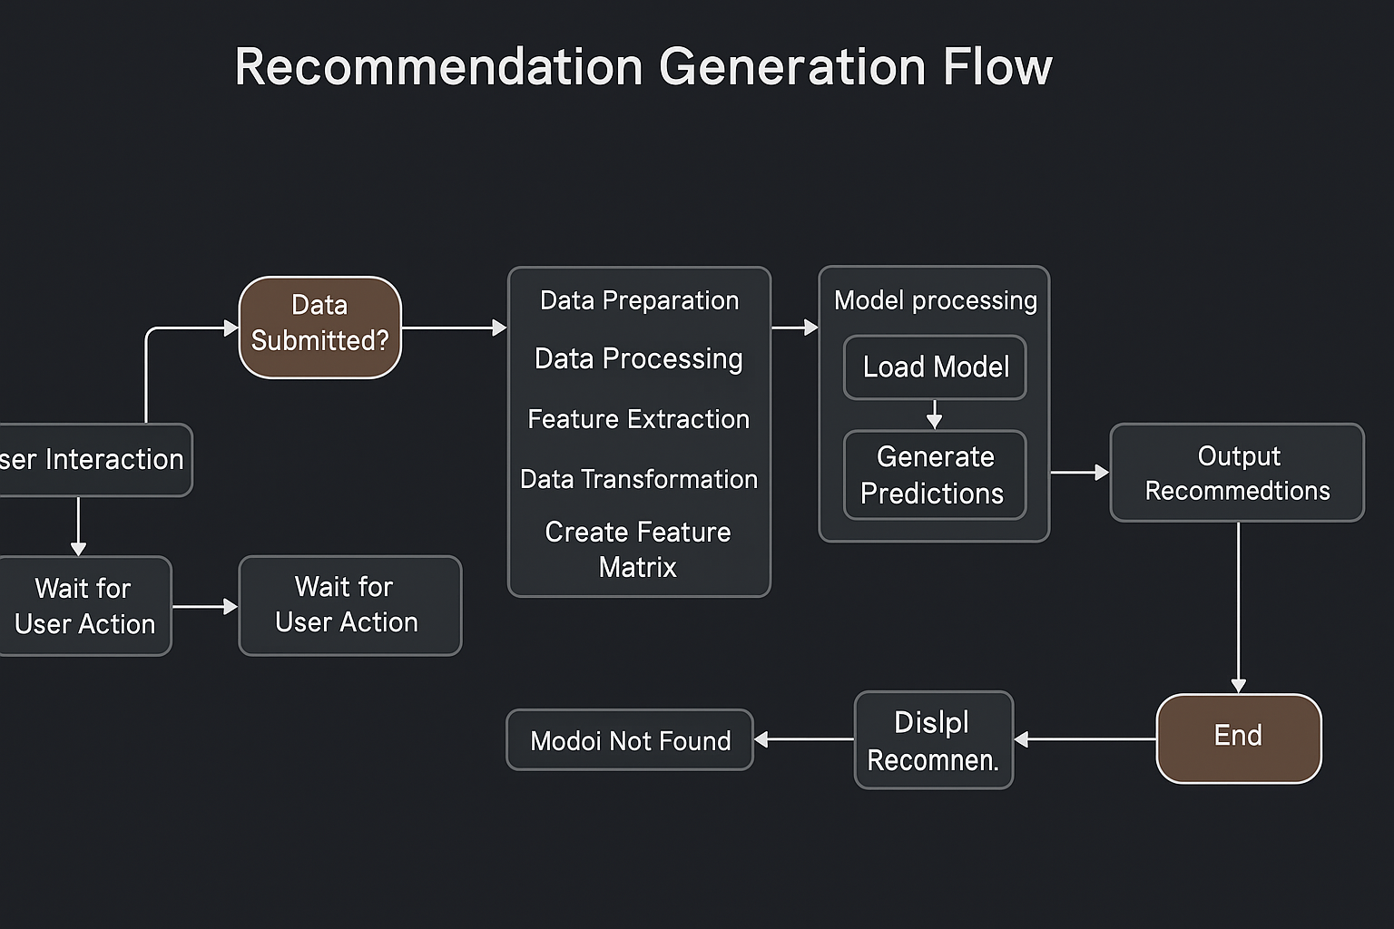
System Architecture
Second Review
Department of Computer Science and Engineering

Slide 8
List of Modules
Movie Recommendation Engine
Collaborative Filtering: Recommend movies based on users with similar preferences and ratings.
Content-Based Filtering: Recommend movies based on the content, like genre, director, actors, or plot keywords.
Hybrid Model: Combining collaborative and content-based filtering for more accurate recommendations.
Personalized Recommendations: Custom recommendations based on a user’s previous interactions, ratings, and preferences.
Search & Filtering System
Search Functionality: Allow users to search movies by title, genre, release year, or actors.
Filters: Allow users to filter results based on ratings, release year, genres, etc.
Rating & Review System
Rating Module: Users can rate movies they have watched.
Review System: Allow users to write and read movie reviews.
Movie Details Page
Movie Information: Display detailed information about the movie (synopsis, cast, ratings, trailers, reviews).
Similar Movies: Display similar movies or suggestions based on the current movie.
Watchlist/Save for Later: Users can save movies to watch later.
Recommendation Display
Trending/Popular Movies: Show trending or popular movies.
Recently Watched: Show the most recent movies watched by the user.
Personalized Movie List: Display movie recommendations personalized for the user.
Second Review
Department of Computer Science and Engineering

Slide 9
Functional Description for each modules with DFD and Activity Diagram
Movie Data Collection & Database: This module gathers and stores movie-related information from external APIs, including genres, descriptions, cast, and ratings. It maintains a structured database that is periodically updated to ensure data freshness.
Movie Recommendation Engine: The engine generates personalized movie suggestions using Collaborative Filtering, Content-Based Filtering, and a Hybrid model, based on user interactions, ratings, and metadata.
Search & Filtering System: This module enables users to search for movies and filter results by genre, release year, rating, and more. It parses user queries and narrows down results efficiently.
Rating & Review System: Users can rate and review movies they have watched. The system collects this data, updates average ratings, and displays user-generated reviews for better insights.
Movie Details Page: When a user selects a movie, this module fetches and displays its details, including trailers, synopsis, cast, and related movies.
Recommendation Display: It presents trending, popular, and personalized movie lists to users, offering them curated suggestions based on their preferences and watch history.
Second Review
Department of Computer Science and Engineering

Slide 10
Implementation & Results of Module
Implementation: The implementation phase involves developing each module as described, integrating them into a unified application, and ensuring smooth communication between components. Technologies such as React for the frontend, Node.js for the backend, and MongoDB for data storage are utilized. API integration for fetching movie details, and collaborative filtering algorithms for recommendations are part of the core implementation.
Result: After successful implementation, the application provides users with a seamless platform to explore movies, get recommendations, review and rate films, and receive updates on new releases. Admins can effectively manage content, while users experience a rich, personalized interface that enhances movie discovery.
Second Review
Department of Computer Science and Engineering

Slide 11
Conclusion & Future Work
Result: After successful implementation, the application provides users with a seamless platform to explore movies, get recommendations, review and rate films, and receive updates on new releases. Admins can effectively manage content, while users experience a rich, personalized interface that enhances movie discovery.
Conclusion: The Movie Recommendation App successfully brings together various modules to deliver a seamless and personalized movie discovery experience. Its robust recommendation engine, coupled with user-friendly search and filter options, ensures users find relevant content quickly. The system's modular architecture allows for easy maintenance and future enhancements, making it scalable and adaptable to new technologies.
Future Work: Future enhancements could include the integration of advanced machine learning models for more accurate recommendations, voice-based search functionality, and real-time collaborative viewing experiences. Expanding the admin panel for more granular control and adding social features for user interaction could also enrich the platform's engagement and usability.
Second Review
Department of Computer Science and Engineering

Slide 12
References
Goldberg, D., Nichols, D., Oki, B. M., & Terry, D. (1992). Using collaborative filtering to weave an information tapestry. Communications of the ACM. This foundational paper introduced the concept of collaborative filtering, laying the groundwork for modern recommendation systems by using historical user interactions to predict preferences.
Balabanović, M., & Shoham, Y. (1997). Content-based, collaborative recommendation. Communications of the ACM. This research explores content-based filtering and its integration with collaborative methods to enhance recommendation accuracy.
Koren, Y., Bell, R., & Volinsky, C. (2009). Matrix factorization techniques for recommender systems. IEEE Computer An in-depth look at collaborative filtering techniques, discussing user-based, item-based, and model-based methods.
Second Review
Department of Computer Science and Engineering

Slide 13
Paper Publication Status
Yet To Publish
Second Review
Department of Computer Science and Engineering

Slide 14
Thank You
Second Review
Department of Computer Science and Engineering

